Slide 1
Unveiling the All-New Ontario Colleges Website
OSCA Conference
November 10, 2025
Presented by: Chris Accardi

Slide 2

Unveiling the All-New
Ontario Colleges Website
Helping Students Explore with Confidence

Slide 3
Hi, I’m Chris!
From OCAS
and I want to show you some improvements we made to our new Ontario Colleges website!

Slide 4





Agenda
Introduction
Background Info
Major Updates
Improvements for Applicants
Questions & Comments

Slide 5
Background

Slide 6
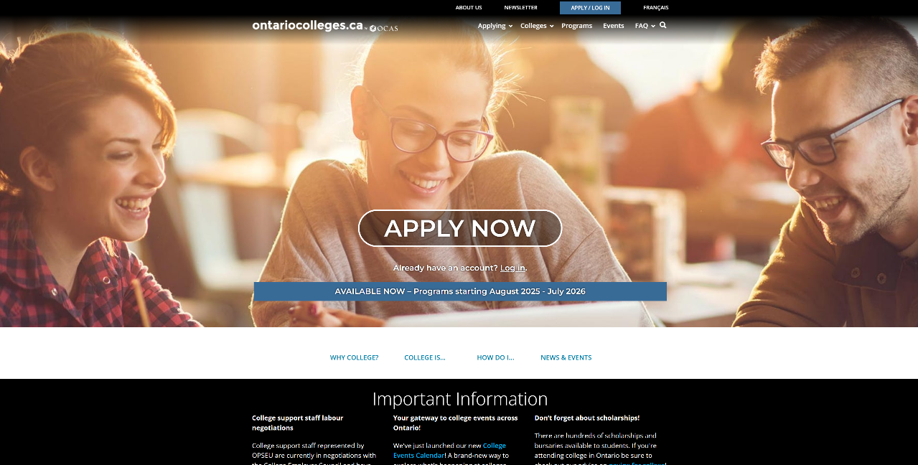
Time for Change

Slide 7




Project Goals
Built on a
Strong Foundation
Modern Feel
Easily Find
Information
Aligns with
User Expectations

Slide 8
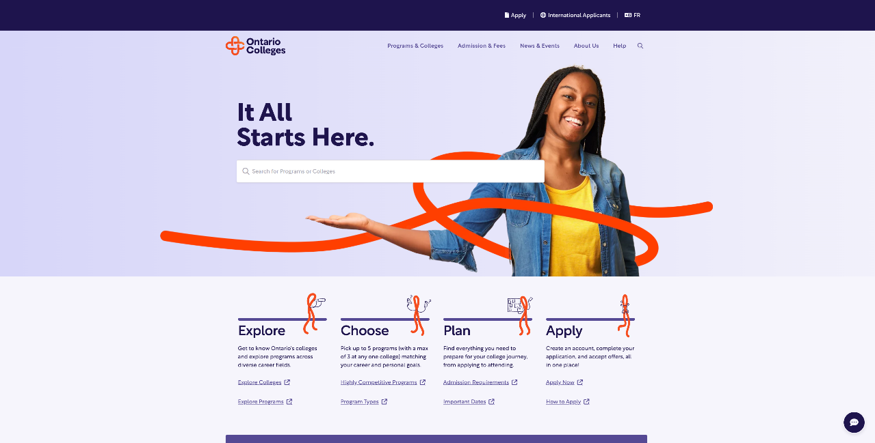
Background

Slide 9
Challenges – One Size Doesn’t Fit All
Users have different needs, levels of understanding, and preferences.
How do we make a website tailored to millions of unique viewers?
How do we deliver clarity without overwhelming users?

Slide 10
Challenges - Conflicting Feedback
Here’s an example of actual feedback we received that shows how difficult it is to make everyone happy.
“Your website has too many words.”
Vs.
“I love how detailed your website is; it makes things very easy to understand.”

Slide 11
From Feedback to Action

Slide 12
“Where do I start?”
Feedback we’ve heard:

Slide 13
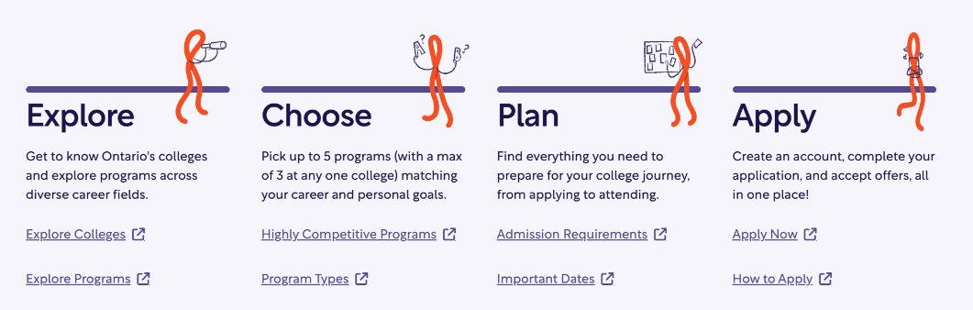

Clear Starting Point and Next Steps
Structured around 4 main areas – Explore, Choose, Plan, Apply
Natural flow that enables users to learn what needs to be done at each stage of the application.

Slide 14
“The website looks dull. It’s too black and white.”
Feedback we’ve heard:

Slide 15


Slide 16


Slide 17
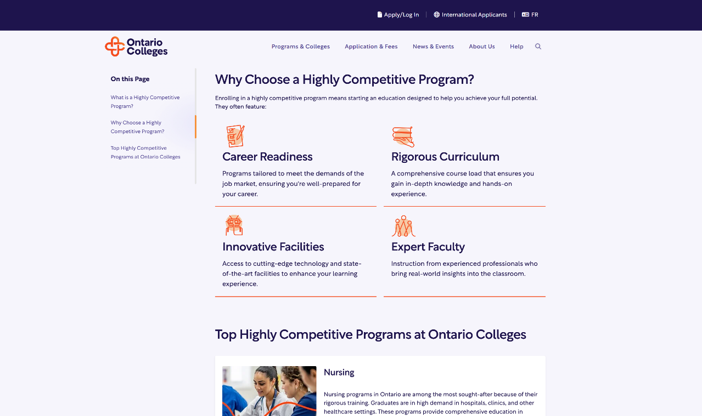

Slide 18
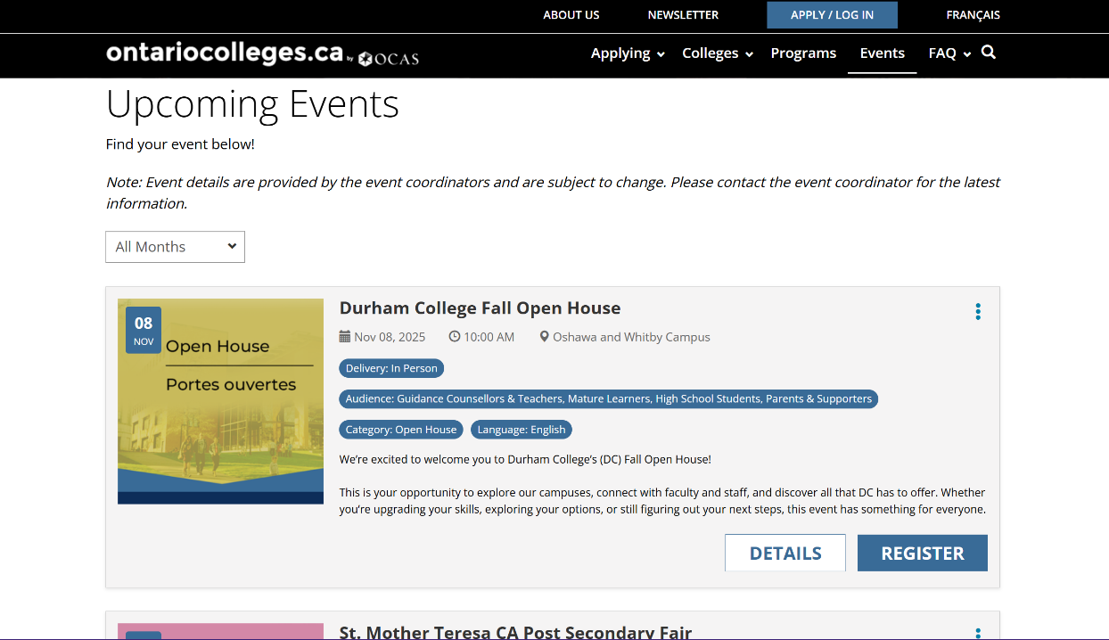

Slide 19
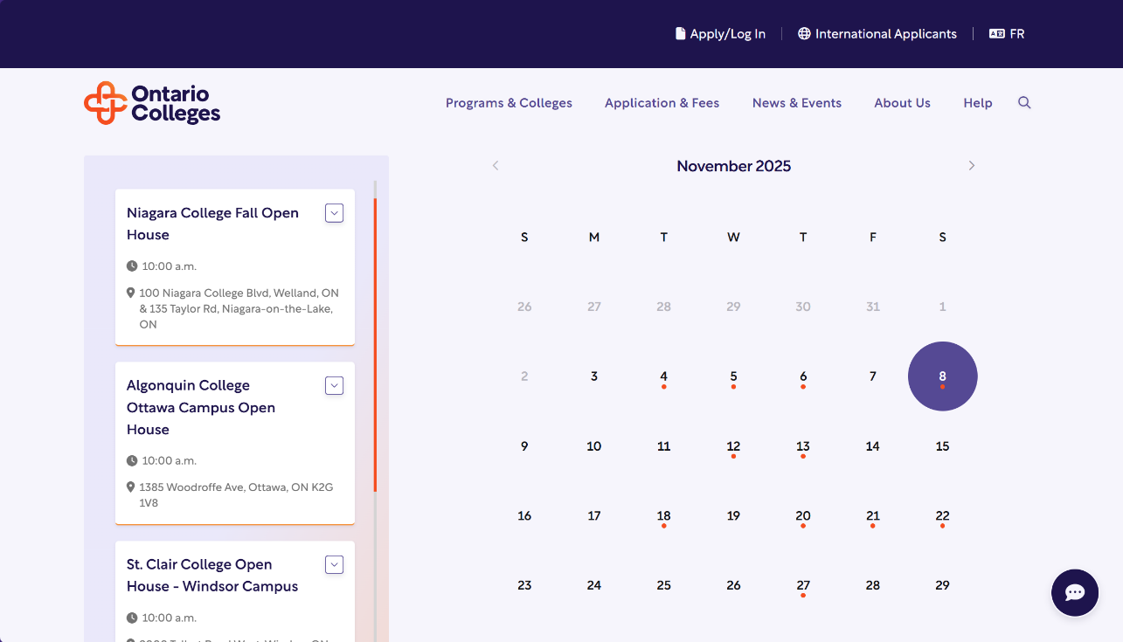

Slide 20







Our style!

Slide 21
“The information on the website is too general. How do I know what applies to specific applicant types?”
Feedback we’ve heard:

Slide 22

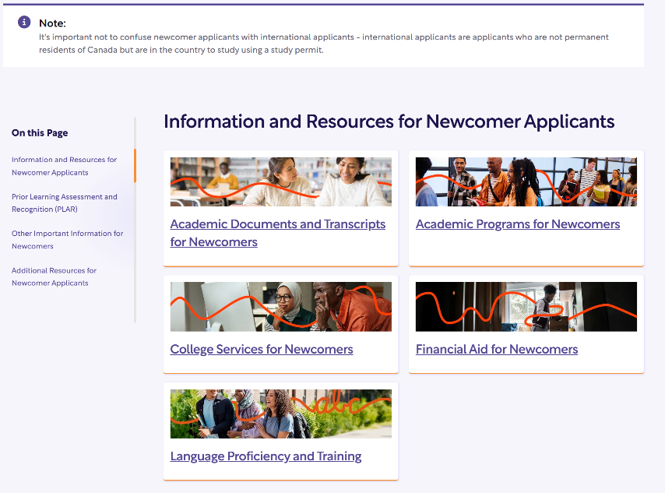


Slide 23
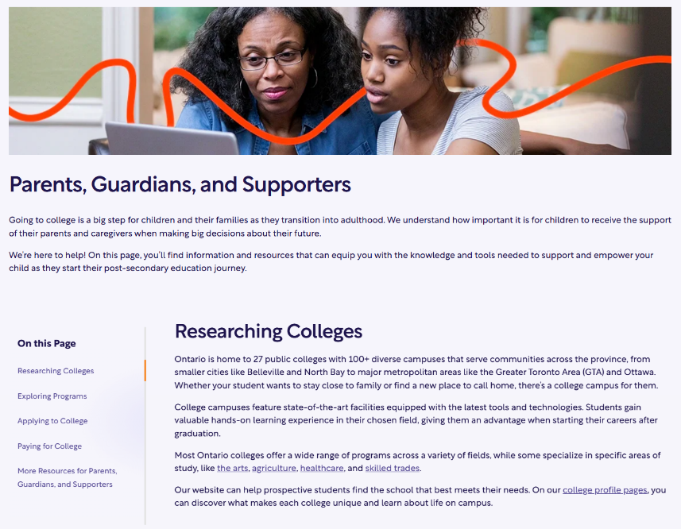

Slide 24

?
What other groups would you like resources for?

Slide 25
“Navigation is cluttered; pages get buried, and it’s visually overwhelming.”
Feedback we’ve heard:

Slide 26
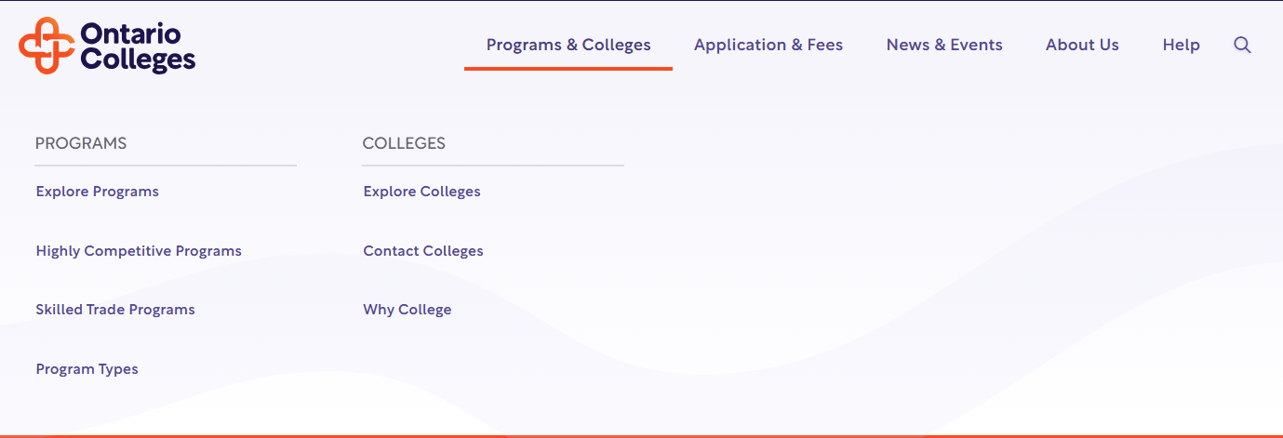

Slide 27
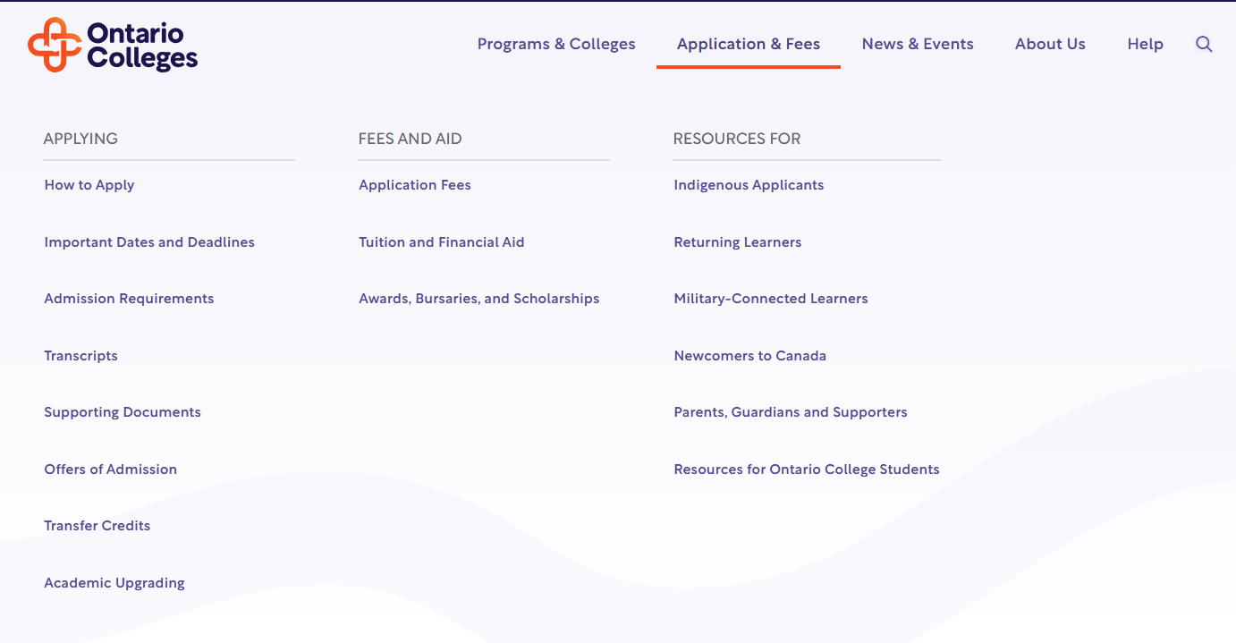

Slide 28
“Financial Aid content is lacking.”
Feedback we’ve heard:

Slide 29

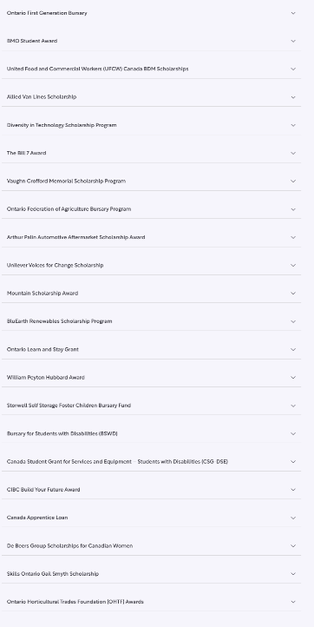
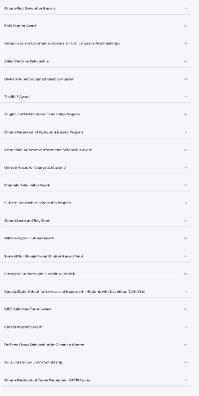

Slide 30
“Programs should be broken down by categories and careers”
Feedback we’ve heard:

Slide 31
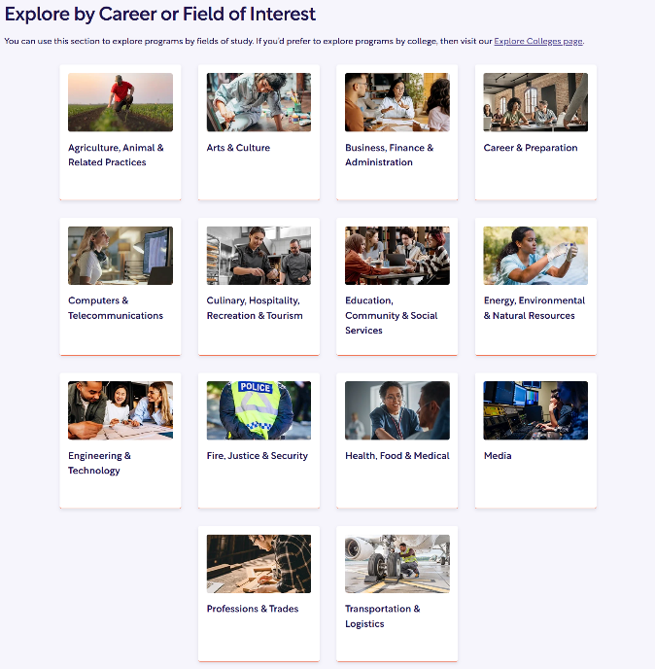
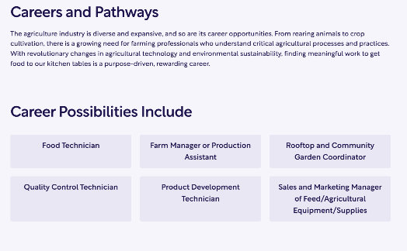

Slide 32
“Interest options quiz”
Feedback we’ve heard:

Slide 33
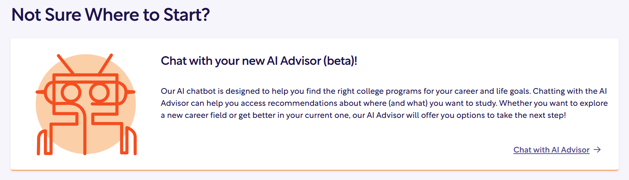

Slide 34
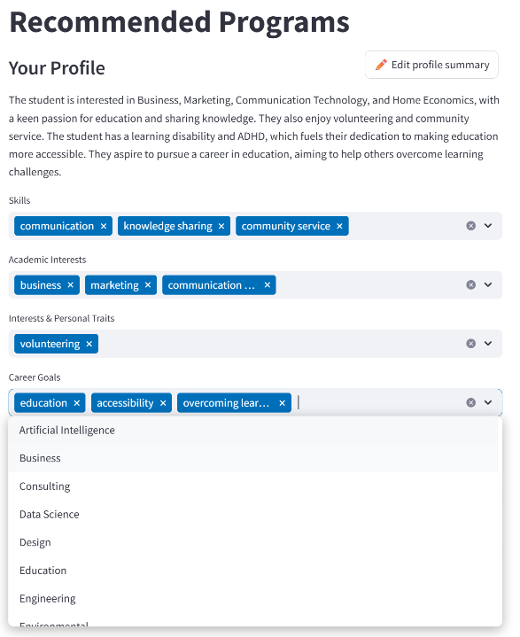
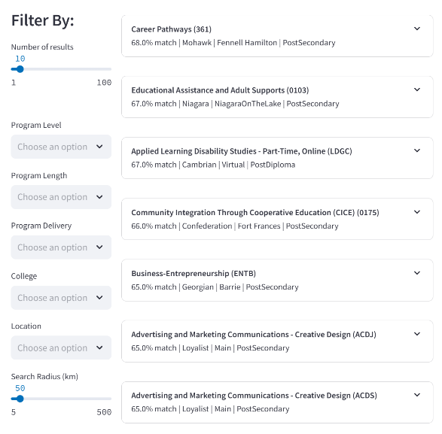

Slide 35
“Too much text; users prefer visuals, videos, and simpler layouts.”
Feedback we’ve heard:

Slide 36
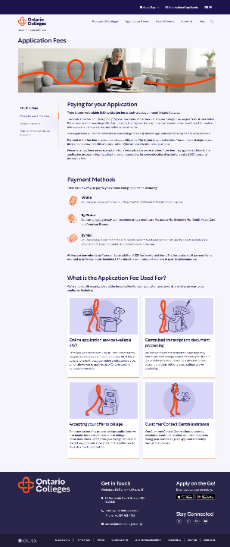
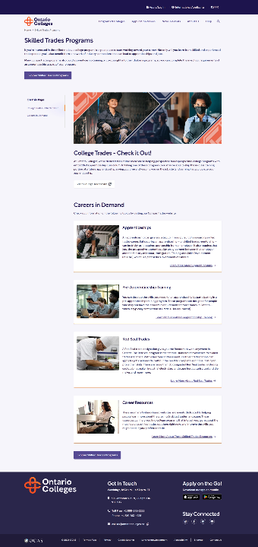
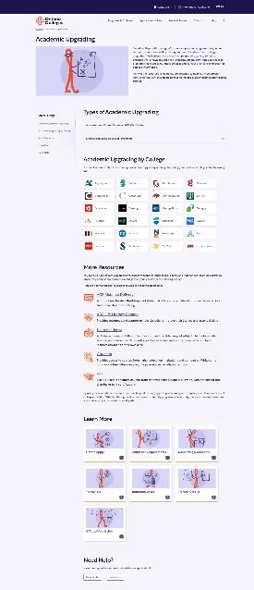

Slide 37
“Improved access to ON to College newsletter archives”
Feedback we’ve heard:

Slide 38
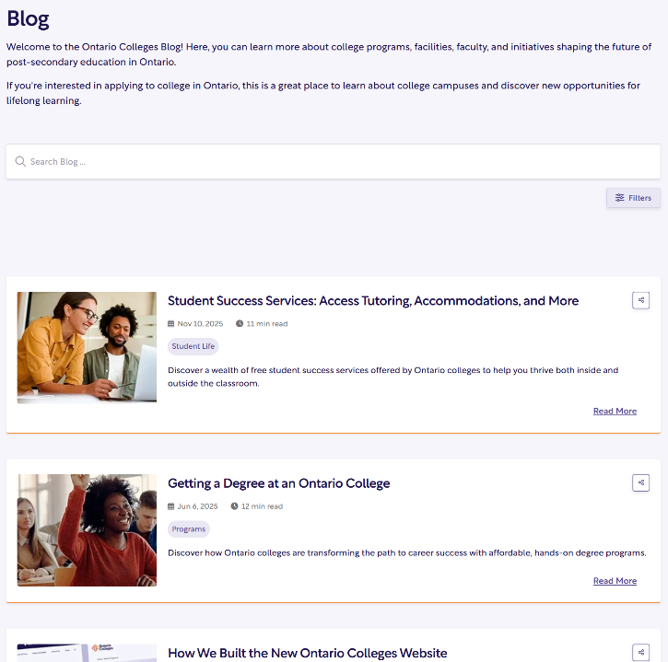

Slide 39
?
What type of new blog content would you like to see?

Slide 40
Making it Easier to Find and Apply to College Programs

Slide 41

Access to New Content
Blog -
News -
Events -
Focusing on featured programs, services, tips & tricks, and new initiatives.
Keep up to date with valuable college information, partnerships, and student success stories.
All college events in one location.
*Remember to submit your school’s events!

Slide 42
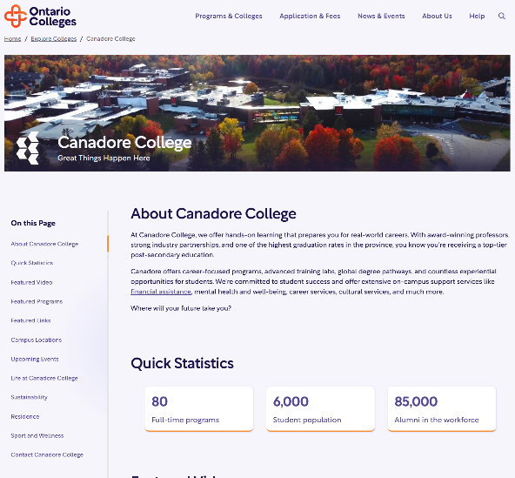
Improved College Profile Pages

Slide 43

Improved College Profile Pages

Slide 44
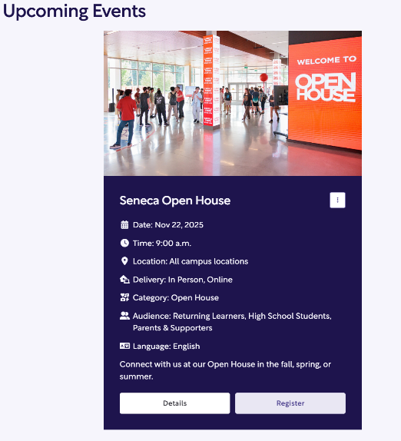
Improved College Profile Pages

Slide 45
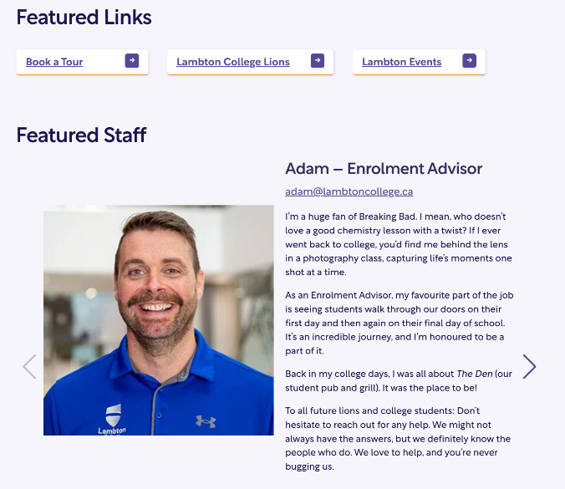
Improved College Profile Pages

Slide 46
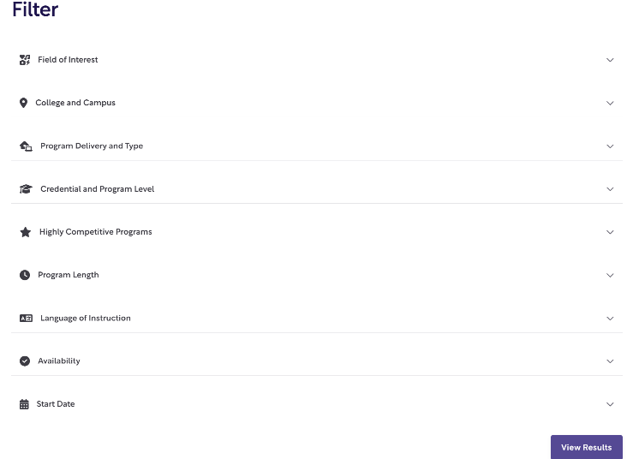

Improved Program Search

Slide 47
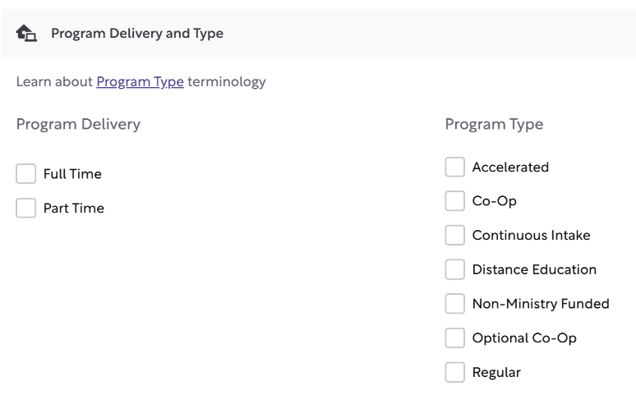
Improved Program Search

Slide 48
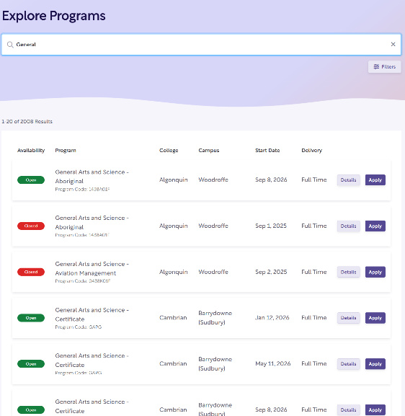
Improved Program Search

Slide 49
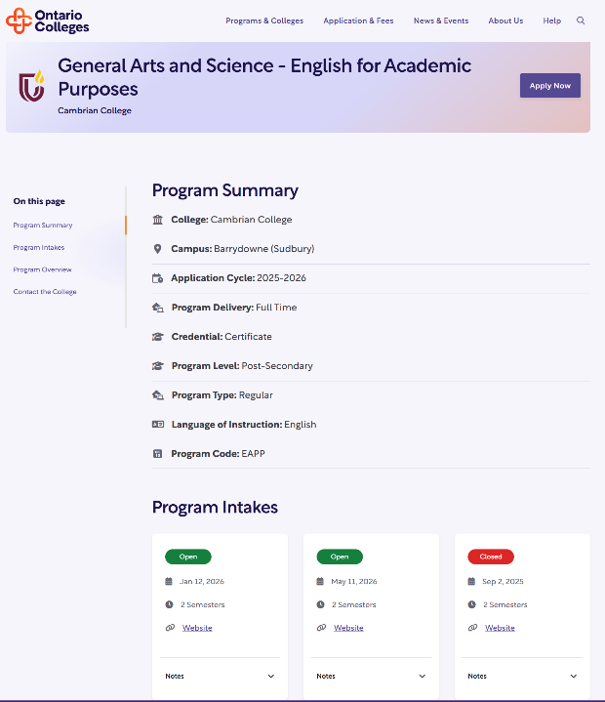
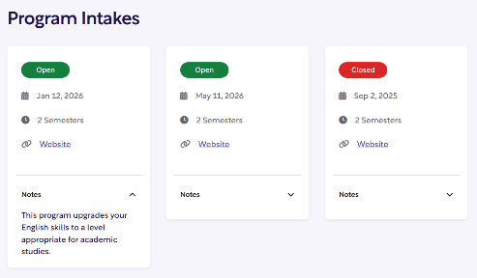
Program Pages

Slide 50
Positive feedback
"Everything seems to very meticulously placed to be as efficient as possible without being cluttered or overwhelming.”
“The pages I've seen so far are a breeze to scan, and whenever I want to know more, that information is right there as a button link or accordion."
“Professional and modern"
"I might just apply again to college just to use this [new ontcol] site.”

Slide 51
Positive feedback
“Amazing! Whatever information I need is so easy to find in tabular format vs paragraphs.”
“The program summary information at the top of the page is great. Everything I would need in a little sound bite.”
“I wanted a ‘more details’ button and then it was there! Mind read.”

Slide 52
?
Questions or Comments?

Slide 53

That’s a lot of information!
Video Overviews
1-2 min long
General overview
2-3 key features
Find them on the Resources for High School Partners page on ocas.ca

Slide 54
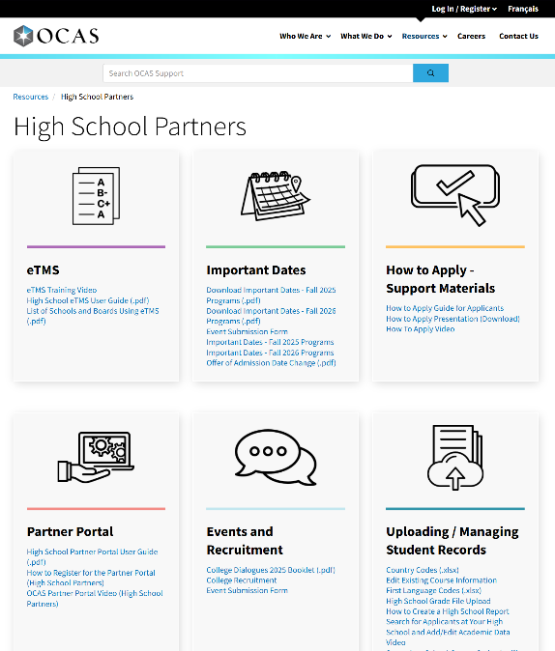


Slide 55

Evolving the site together!

Slide 56

The new
Human Energetic Insightful

