Slide 1

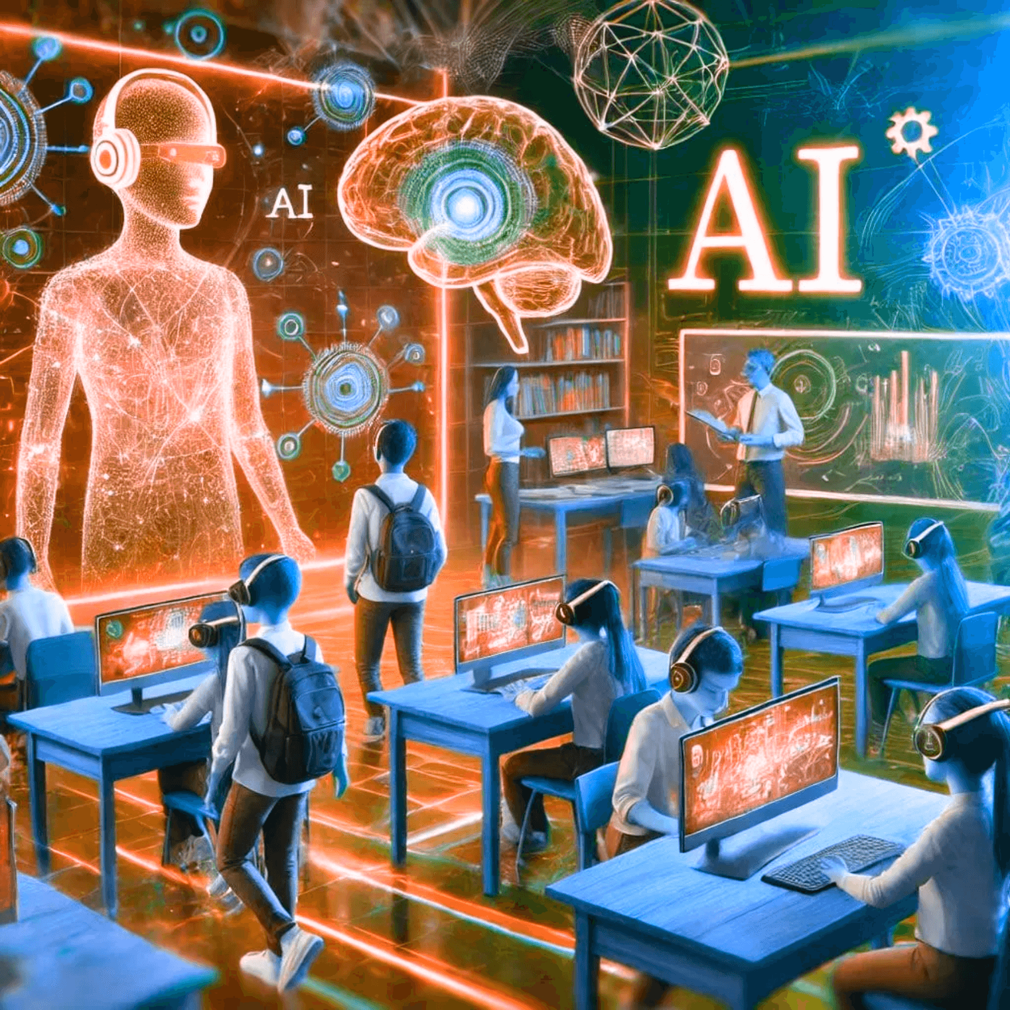
AI IN EDUCATION
PREPARING STUDENTS FOR AN AUTOMATED FUTURE
Presented at OSCA/ACOSO Fall Conference 2025
Founder of Tempus Innovation InTempo
Senior Solutions Architect at Tranquilla AI
Taj Sarin
01

Slide 2



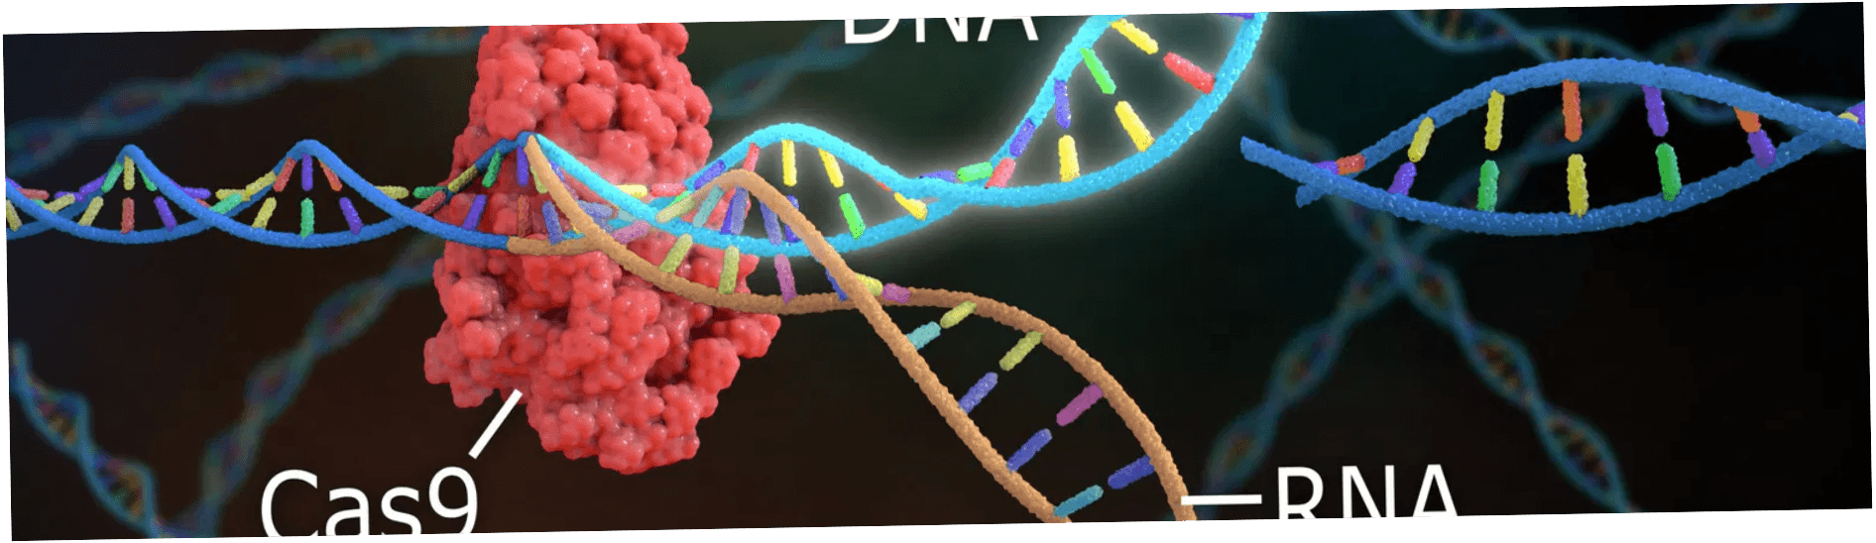
WE LIVE IN THE MOST
EXCITING TIME IN HUMAN HISTORY
WITNESS THE IMPOSSIBLE BECOMING REALITY
Rockets land themselves with pinpoint precision, returning from the edge of space to touch down exactly where they launched. What once seemed like science fiction is now routine engineering.
Humanoid robots walk among us, learning to navigate our world, assist in our homes, and work alongside humans in ways that blur the line between machine and companion.
We edit the code of life itself—CRISPR technology allows us to rewrite DNA, cure genetic diseases, and fundamentally reshape what it means to be human.
"This is not the future—this is NOW. And our students will inherit a world more extraordinary than any generation before them."
02

Slide 3

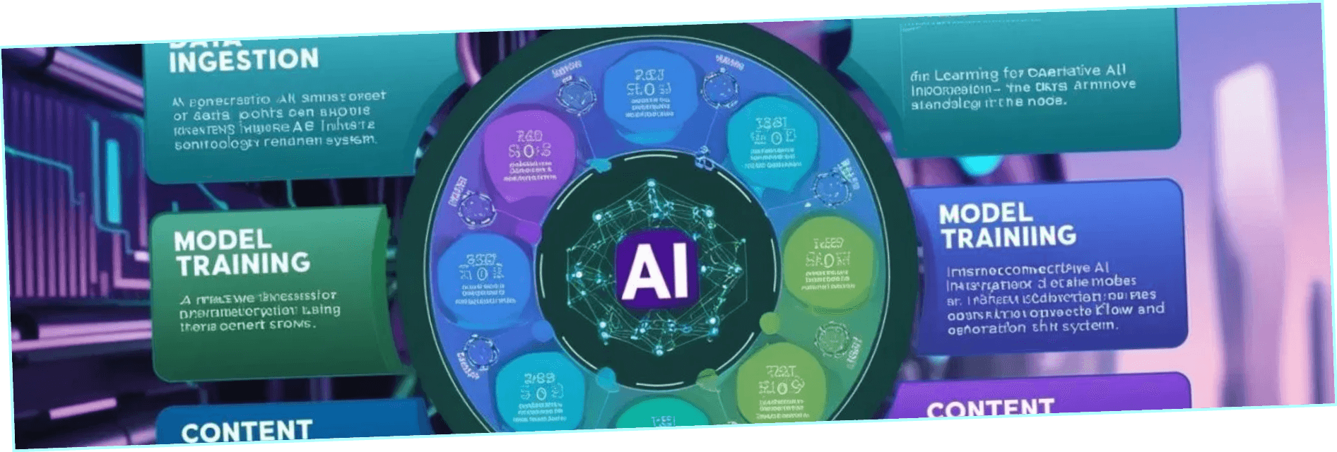
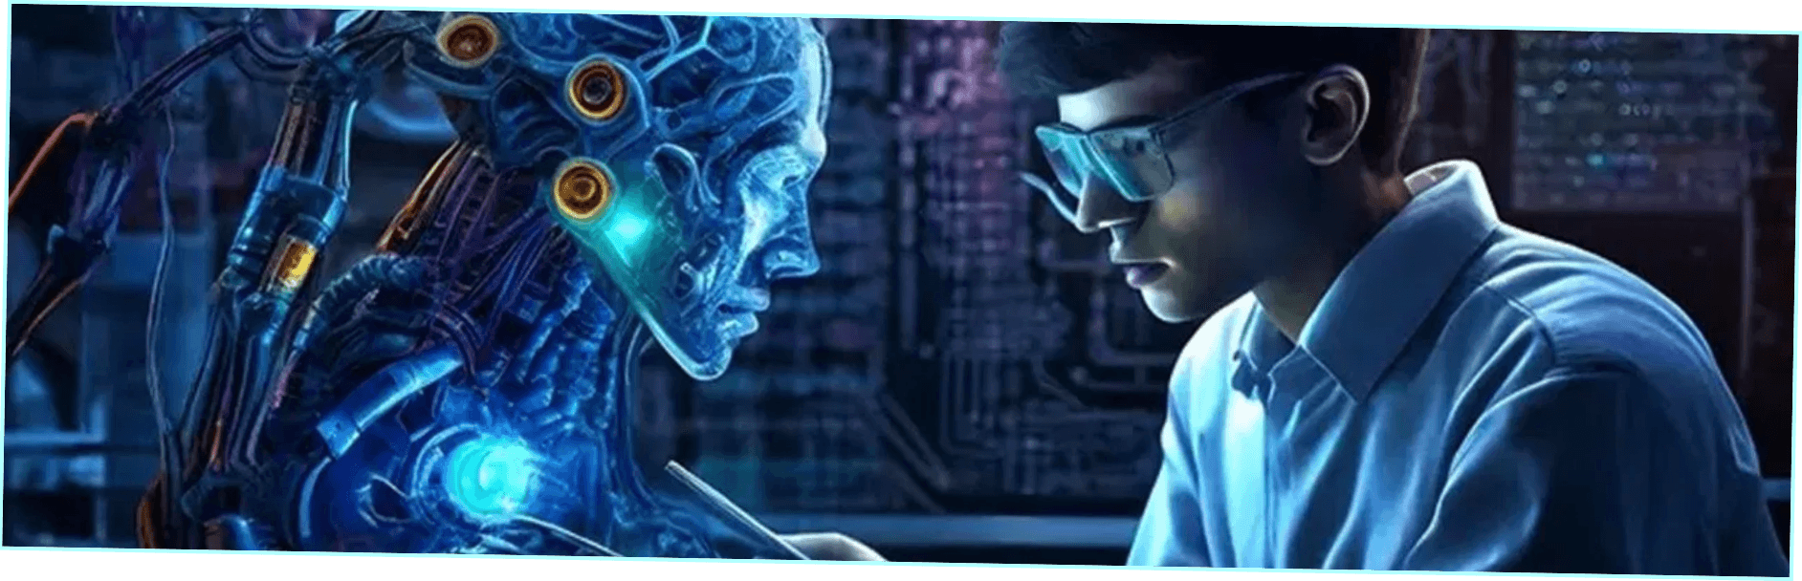
I
N
P
U
HUMAN + AI
T
+
AI
=
O
U
T
P
U
T
= AMPLIFICATION
THE CREATIVE REVOLUTION
Generative AI doesn't replace human creativity—it amplifies it. Three core capabilities transform how we learn, create, and innovate.
Natural Language Understanding: AI comprehends context, nuance, and intent—conversing like a knowledgeable partner.
Content Creation Across Modalities: From text to images, music to code—AI generates sophisticated outputs across every creative domain.
Creative Amplification: Students with ideas but limited technical skills can now bring visions to life—democratizing creative expression.
The barrier between imagination and creation dissolves
03

Slide 4

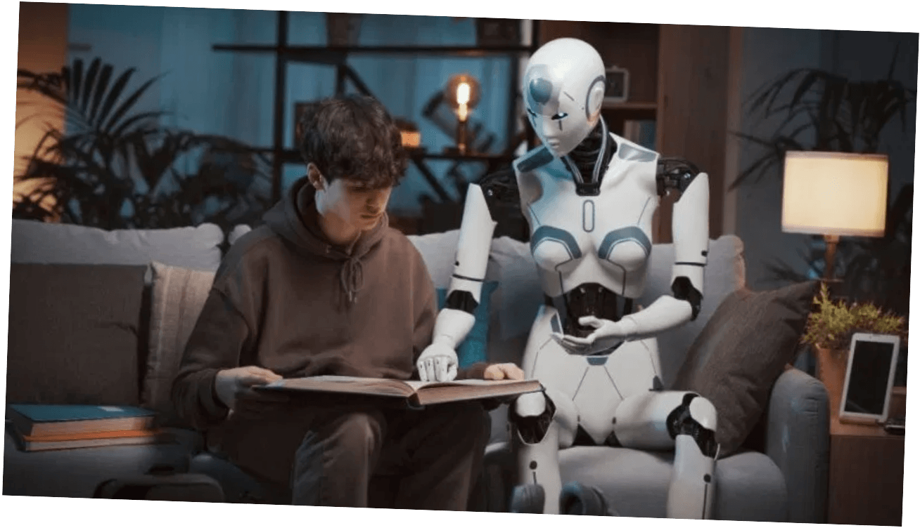
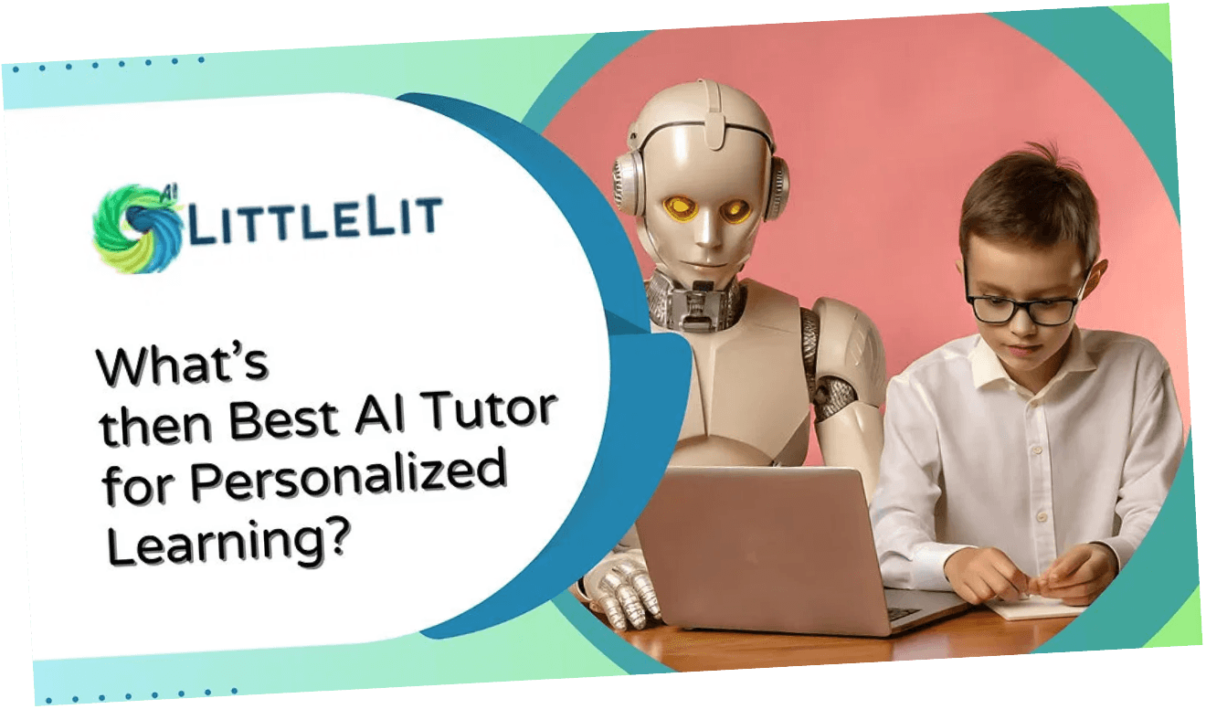
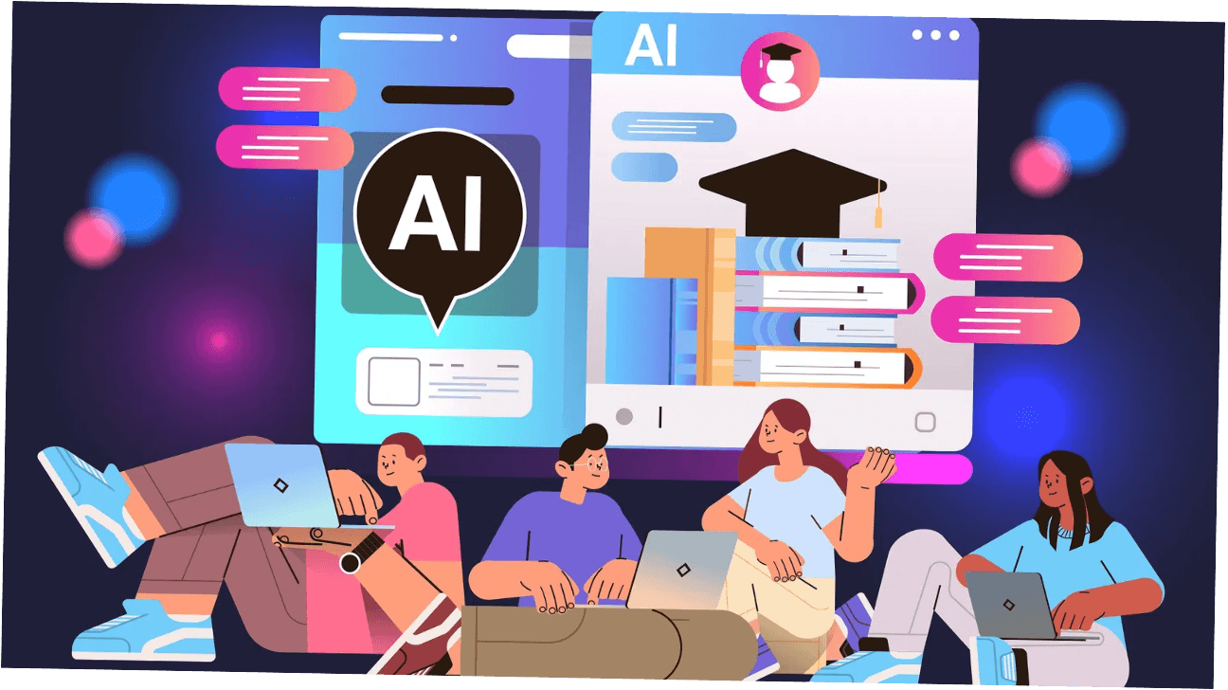
AI AS THE ULTIMATE
PERSONALIZED TUTOR
24/7 AVAILABLE
LEARNING REIMAGINED
Personalized Learning Paths: AI analyzes each student's strengths, weaknesses, and learning style—tailoring content to their unique needs.
Instant Feedback: No more waiting days for graded assignments. AI provides immediate, constructive feedback that accelerates learning.
ADAPTIVE LEARNING
Adaptive Teaching Styles: AI adjusts explanations, examples, and difficulty levels in real-time based on student comprehension.
24/7 Availability: Learning doesn't stop at 3pm. AI tutors are always available, creating equity for students without access to expensive private tutoring.
"Every student deserves a tutor who never tires, never judges, and always adapts."
04
INSTANT FEEDBACK

Slide 5




AI UNLEASHES CREATIVITY
DEMOCRATIZING CREATIVE EXPRESSION
Visual Arts: Students create stunning artwork without years of technical training—AI tools like Midjourney and DALL-E transform imagination into visual reality
Music & Audio: Compose original soundtracks, generate voice narration, and produce professional-quality audio without expensive equipment or formal training
Writing & Storytelling: AI assists with brainstorming, outlining, and refining narratives—amplifying student voice rather than replacing it
Design & Prototyping: Create website mockups, product designs, and interactive prototypes—bringing entrepreneurial ideas to life
05

Slide 6

LIVE DEMONSTRATION
BUILDING AN AI ASSISTANT IN REAL-TIME
Watch as we create a functional "Career Discovery" AI assistant using Hume AI's empathic voice technology—demonstrating how accessible AI development has become.
LIVE
DEMONSTRATION GOAL
DEMO
Create a conversational AI that helps students explore career pathways based on their interests and passions
TECHNOLOGY SHOWCASE
Hume AI's empathic voice interface—AI that recognizes and responds to emotional cues in conversation
TIME TO BUILD
Less than 5 minutes from concept to functional prototype—no coding required
"Students can now create sophisticated AI applications as easily as they create presentations"
06

Slide 7

FIVE STEP BUILD PROCESS
STEP 1: DEFINE AI'S ROLE
Simple prompt: "You are a career counselor helping high school students explore careers based on their interests"
STEP 2: CONFIGURE EMPATHIC VOICE
Select warm, encouraging tone settings—AI will recognize emotional cues and respond with appropriate empathy
BUILD
STEP 3: DEPLOY THE AGENT
Click "Launch"—the AI agent is live and ready to interact in under 60 seconds
STEP 4: LIVE CONVERSATION
IN 60 SEC
Ask: "I love video games and art—what careers might fit me?" and watch the AI respond in real-time
STEP 5: EMPATHETIC RESPONSE
AI suggests: game design, UI/UX design, concept art, animation—with personalized explanations and encouragement
KEY TAKEAWAY: Students can create sophisticated AI applications as easily as presentations—opening new avenues for project-based learning
07

Slide 8

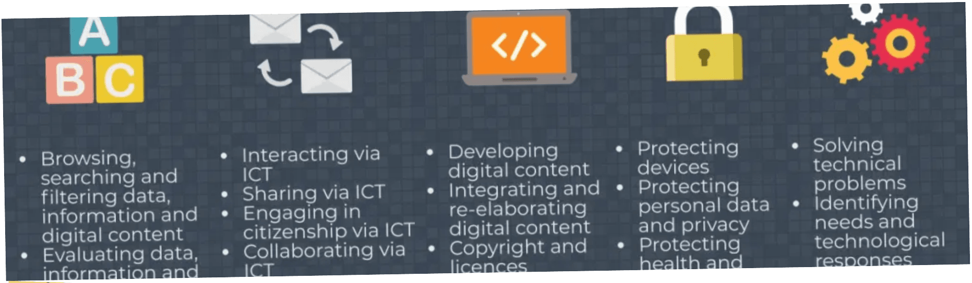

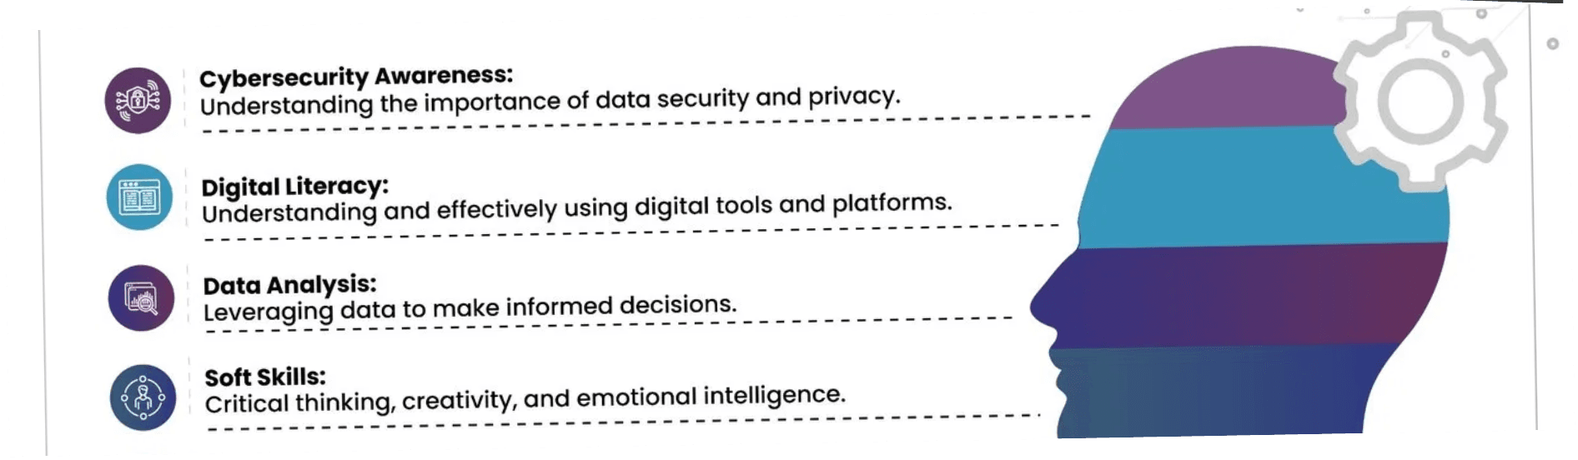
THE SKILL SHIFT
TOMORROW'S WORKFORCE REQUIRES NEW COMPETENCIES
YESTERDAY'S SKILLS
TOMORROW'S SKILLS
• Memorization
• Prompt engineering
• Following instructions
• AI ethics & judgment
• Repetitive execution
• System integration
• Individual expertise
• Creative co-creation
The shift is fundamental:
AI, not compete against it. Those who master AI collaboration will thrive—those who resist will be left behind.
Students must learn to work
with
08

Slide 9

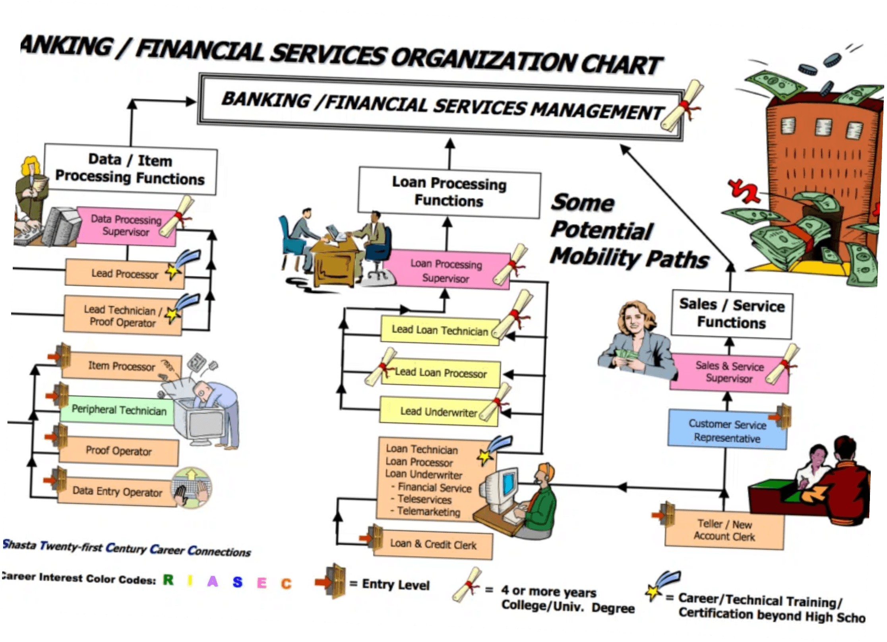
THE INTEMPO
SOLUTION
SHSM CERTIFICATIONS FOR THE AI ERA
InTempo provides turn-key SHSM programs that integrate AI literacy into sector-specific career pathways—preparing students for tomorrow's workforce today.
SECTOR-SPECIFIC AI TRAINING
Healthcare, Business, Arts, Technology—AI applications tailored to each SHSM sector
EXPERIENTIAL LEARNING
Hands-on projects with cutting-edge AI tools like Hume AI, Manus AI, and Grok3
CERTIFICATION PATHWAYS
Recognized credentials that demonstrate AI competency to employers and post-secondary institutions
"Preparing students for careers that don't exist yet—with skills that will always be relevant."
TURN-KEY IMPLEMENTATION
Complete curriculum, materials, and support—ready to deploy in your school
Visit: tempusinnovation.com/intempo
09

Slide 10

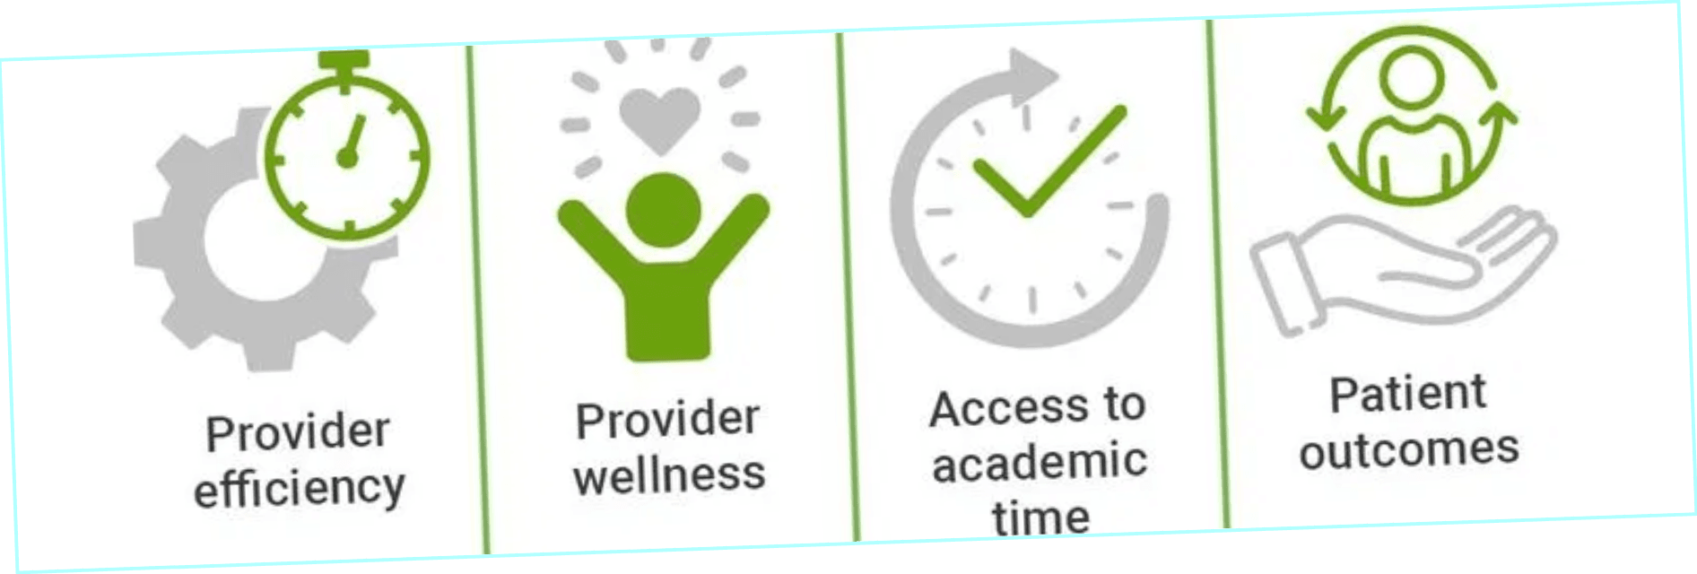

E
M
P
A
T
H
Y
+
AI
=
H
E
A
L
I
N
G
AI WITH PURPOSE
EMPATHIC TECHNOLOGY FOR WELLNESS
Tranquilla.ai: Developing empathic AI companions for veterans and individuals facing psychological challenges—demonstrating how AI careers can be deeply mission-driven.
EMOTIONAL RECOGNITION
AI systems trained to recognize emotional cues and respond with genuine empathy
24/7 MENTAL HEALTH SUPPORT
Complements human therapists with always-available assistance
PRIVACY-FOCUSED DESIGN
Creates safe spaces for vulnerable conversations
EVIDENCE-BASED TECHNIQUES
Delivers therapeutic techniques through conversational AI
10

Slide 11

MISSION-DRIVEN AI CAREERS
STUDENT CAREER IMPLICATIONS
AI careers are not limited to Silicon Valley tech companies. Students can pursue AI work that directly helps people—combining technology skills with psychology, healthcare, social work, and human services.
PURPOSE
DRIVEN
TECHNOLOGY REFLECTS VALUES
AI is a tool—it reflects the values of those who create it. Students entering this field can shape technology that serves humanity's highest aspirations: healing, connection, equity, and wellbeing.
AI careers can be deeply mission-driven and focused on helping people
11

Slide 12

COUNSELORS AS GUIDES
THREE ESSENTIAL ACTIONS EDUCATORS CAN TAKE IMMEDIATELY
YOUR
01 — ADVISE STUDENTS ON AI CAREER PATHWAYS
Actively present AI-related careers as viable, exciting, and accessible options spanning all sectors—healthcare, arts, business, and social services, not just tech companies
ROLE
02 — ENCOURAGE CREATIVE & ETHICAL EXPLORATION
Promote classroom projects where students use AI tools to solve real problems, create original work, and grapple with ethical questions—building competency and critical thinking
03 — CHAMPION FUTURE-READY PROGRAMS
Advocate for programs like SHSM certifications that teach AI literacy alongside sector-specific skills. Push for professional development that keeps you ahead of the curve
12

Slide 13

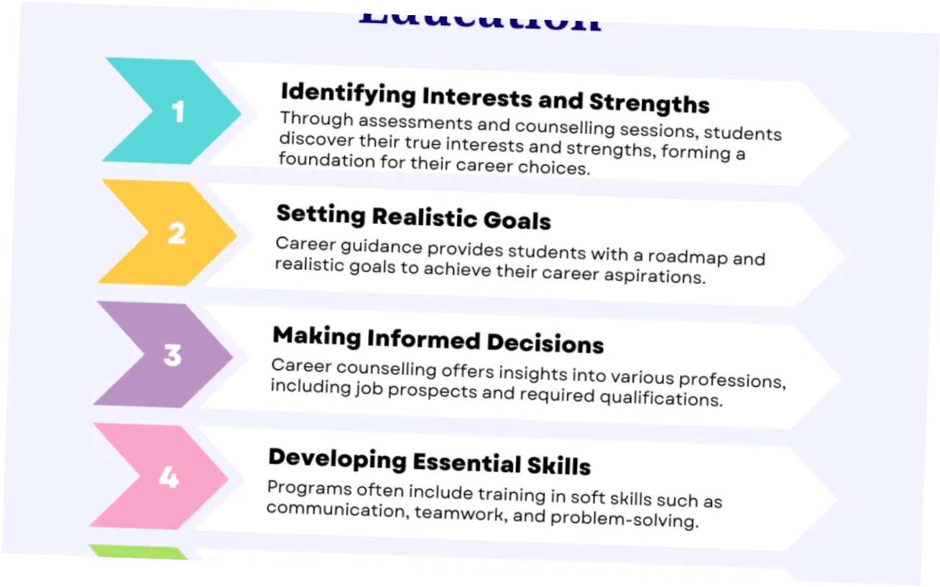

YOUR UNIQUE POSITION
AS BRIDGE TO THE FUTURE
YOUR INFLUENCE IS CRITICAL
As counselors and educators, you are the bridge between students' current reality and their future possibilities. Your encouragement, guidance, and advocacy directly shape whether students see themselves as passive consumers of AI or active creators and ethical stewards of this transformative technology.
The conversations you have today—the careers you highlight, the programs you champion, the projects you encourage—will determine which students step confidently into the AI era and which are left behind.
"You don't just guide students to careers— you shape the future they will create."
13

Slide 14

EXCLUSIVE OFFER
FREE AI TOOLS WORKSHOP
FREE
Want to try these tools yourself? Join a live, interactive session to explore the coolest AI tools available today.
FREE 1-Hour Evening Workshop: Explore the Coolest AI Tools Available Today
WORKSHOP
FORMAT
DURATION
Live, Interactive Online Session
1 Hour
CONTENT
COST
Hands-On AI Tool Exploration
Completely FREE
14

Slide 15


HOW TO JOIN
REGISTRATION INSTRUCTIONS
Scan the QR code or visit the URL to sign up. Leave your email, and I'll send you an invitation with the workshop date and access link.
Bring your curiosity and questions—this is a judgment-free space to explore and learn together.
The best way to truly understand AI's potential is to use it yourself. This workshop provides a risk-free, guided environment to experiment with tools that can enhance your professional practice and deepen your ability to guide students.
RSVP
15

Slide 16

THANK YOU
LET'S CONTINUE THE CONVERSATION
Q&A
Thank you for your time and attention. The future is arriving faster than ever, and our students are counting on us to help them navigate it with confidence, creativity, and purpose.
QUESTIONS
I hope this presentation has inspired you to see AI not as a threat to education but as a powerful tool for unlocking human potential.
I'm here to answer your questions and continue this important conversation
16

Slide 17

STAY CONNECTED
EMAIL
✉
consult@tempusinnovation.com
@
🌐
WEBSITE
tempusinnovation.com/intempo
"Together, we can prepare students not just for the future of work—but for the future they will create."
17

